Slide 1
Change Detection in Angular
Dhananjay Kumar
@debug_mode

Slide 2

Dhananjay Kumar
Trainer and Consultant
10 times Microsoft Most Valuable Professional
Google Developer Expert in Angular & Web
Organizer of ng-India
Blog : https://debugmode.net
debugmode@outlook.com
Twitter : @debug_mode

Slide 3
Change Detector
The Change Detector detects the component for the data change and re-render the view to project the updated data.

Slide 4
Every component has its own change detector
Component
Change Detector
1:1

Slide 5
Angular runs change detector :
An event such as click, submit gets fired
XHR call to work with an API
Asynchronous JavaScript functions such as setTimeOut() or setInterval() gets executed.

Slide 6
Angular Component Tree
Root Component
Child Component -1
Child Component- 2
CC-11
CC -12
CC-121
CC -21
CC-22
CC- 211

Slide 7
Angular Component Tree
Root Component
Child Component -1
Child Component- 2
CC-11
CC -12
CC-121
CC -21
CC-22
CC- 211
User clicks a button

Slide 8
Angular Component Tree
Root Component
Child Component -1
Child Component- 2
CC-11
CC -12
CC-121
CC -21
CC-22
CC- 211
User clicks a button

Slide 9
Angular Component Tree
Root Component
Child Component -1
Child Component- 2
CC-11
CC -12
CC-121
CC -21
CC-22
CC- 211
User clicks a button

Slide 10
Angular Component Tree
Root Component
Child Component -1
Child Component- 2
CC-11
CC -12
CC-121
CC -21
CC-22
CC- 211
User clicks a button

Slide 11
Angular Component Tree
Root Component
Child Component -1
Child Component- 2
CC-11
CC -12
CC-121
CC -21
CC-22
CC- 211
User clicks a button

Slide 12
Angular Component Tree
Root Component
Child Component -1
Child Component- 2
CC-11
CC -12
CC-121
CC -21
CC-22
CC- 211

Slide 13
Performance
Angular component tree is a directed graph, which means there is a unidirectional flow of change detector from root to bottom. Angular knows in which direction tree has to be traversed, and there is no circular or bidirectional traversing of the change detector tree.
After a single pass change detection tree gets stable.
Unlike AngularJS, in Angular, there is no generic function to update the view. Since here every component has its own change detector, JavaScript VM can optimize it for better performance.

Slide 14
Reduce Number of Checks ?
App Component
Count Component
Another Child Component (CD)
CD
CD
CD

Slide 15
Change Detection Strategies
Default
onPush

Slide 16
Change Detection Strategies
New Reference is passed to the @Input decorated properties
Data Changes to the @Input decorated properties
Default
onPush

Slide 17
Detached
App Component
Count Component
Another Child Component (CD)
CD
CD
CD

Slide 18
reattach()
App Component
Count Component
Another Child Component (CD)
CD
CD
CD

Slide 19
detectChanges()
App Component
Count Component
Another Child Component (CD)
CD
CD
CD

Slide 20
detectChanges()
App Component
Count Component
Another Child Component (CD)
CD
CD
CD

Slide 21
markForCheck()
Root Component
Child Component -1
Child Component- 2
CC-11
CC -12
markForCheck()
CC -21
CC-22
CC- 211

Slide 22
markForCheck()
Root Component
Child Component -1
Child Component- 2
CC-11
CC -12
markForCheck()
CC -21
CC-22
CC- 211

Slide 23
markForCheck()
Root Component
Child Component -1
Child Component- 2
CC-11
CC -12
markForCheck()
CC -21
CC-22
CC- 211

Slide 24
markForCheck()
Root Component
Child Component -1
Child Component- 2
CC-11
CC -12
markForCheck()
CC -21
CC-22
CC- 211

Slide 25
markForCheck()
Root Component
Child Component -1
Child Component- 2
CC-11
CC -12
markForCheck()
CC -21
CC-22
CC- 211

Slide 26
markForCheck()- Mark parent components up to root component as dirty to be checked.
Root Component
Child Component -1
Child Component- 2
CC-11
CC -12
markForCheck()
CC -21
CC-22
CC- 211

Slide 27
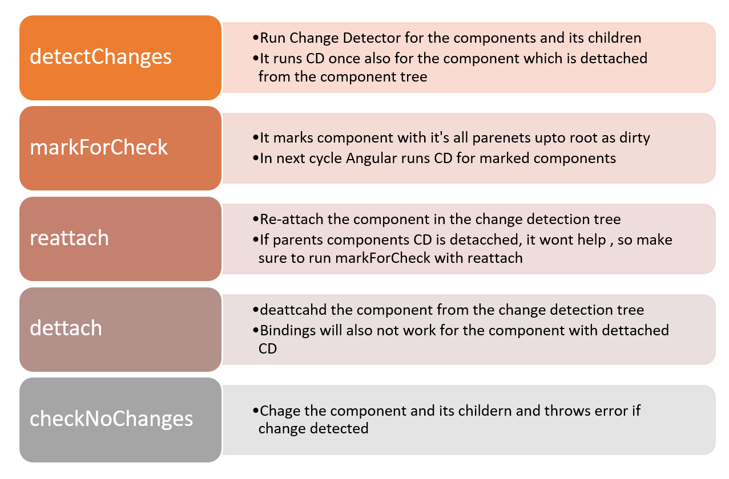

Slide 28
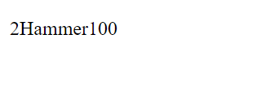
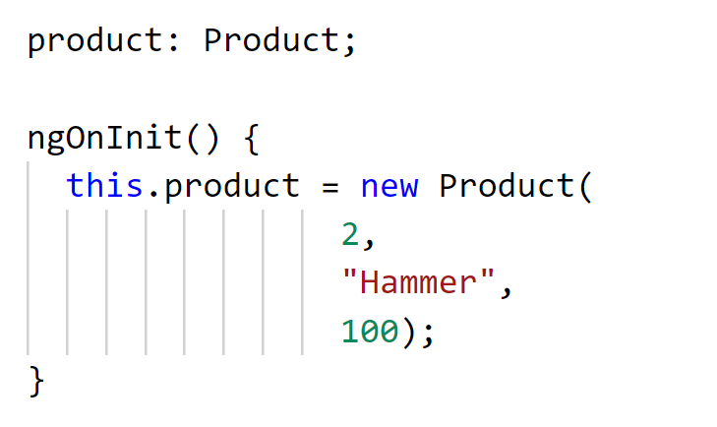
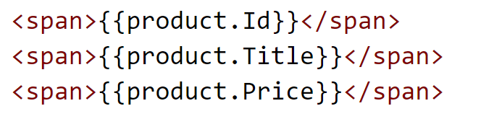
What is Change Detection ?
Data Model
Template

Slide 29

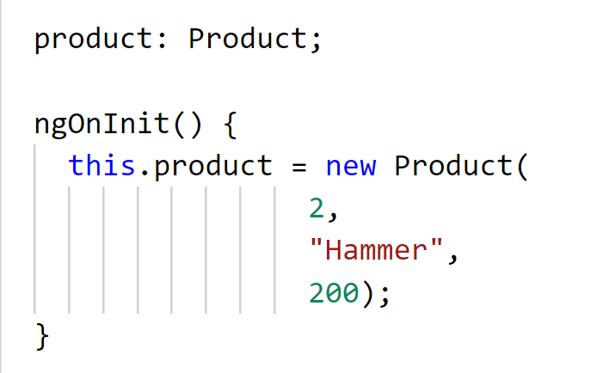
What is Change Detection ?
Data Model
Template

Slide 30
The Magician is
Angular Change Detector

Slide 31
Change Detection
Component
View
1:1

Slide 32
Every Component has it’s own CD
CD
CD
CD
CD
CD
CD

Slide 33
Every Component has it’s own CD
CD
Event

Slide 34
Every Component has it’s own CD
CD
CD
CD
Event

Slide 35
Every Component has it’s own CD
CD
CD
CD
CD
CD
Event

Slide 36
When change detection runs ?
Events – click, submit, …..
2. XHR – Fetching data from a remote server
3.Timers – setTimeout(), setInterval()

Slide 37
Change Detection Strategy
Default
onPush
CD runs when you have new reference of the input data
CD won’t run only if data is mutated
CD will run as usual

Slide 38
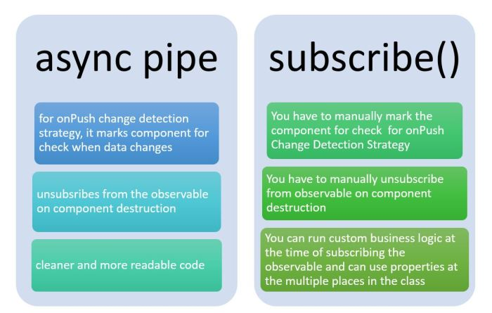
Async pipe

Slide 39
Change Detection Strategy
markForCheck
detach
detectChanges
checkNochanges
Reattach

Slide 40
Change Detection
Demo

Slide 41
Change Detection
Thank You
Reach me for any training and consulting work at debugmode@outlook.com

